Slide 1
Emotion-Based Book Recommender
By: Sanjay Chhetri
Springboard Data Science Capstone
Notes:
Open strong: Emphasize the human problem — emotional distress & why ML matters.

Slide 2
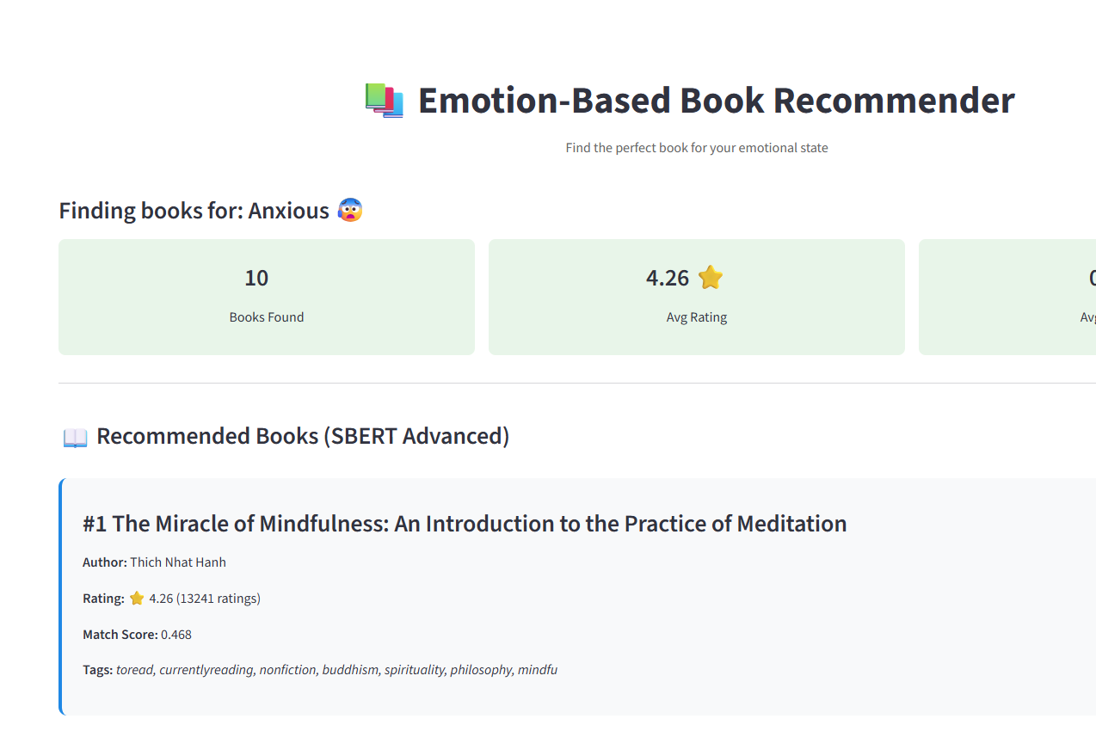

Slide 3

Why This Matters
Teens face rising emotional challenges
Books can help – but choosing the right one is hard
Traditional recommendation: popularity, genre – not emotion
Notes:
Explain why this matters — connect emotionally, mention students.

Slide 4
Project Goal
Match emotional state → most supportive book
Build baseline + advanced ML recommender
Deploy interactive Streamlit app
Notes:
Clarify measurable goal: ML, deploy, emotional alignment.

Slide 5

Dataset
GoodBooks-10k dataset
10k books, 1M reviews
Corpus created from titles + author + top reviews
Notes:
Highlight dataset scale & engineering pipeline.

Slide 6
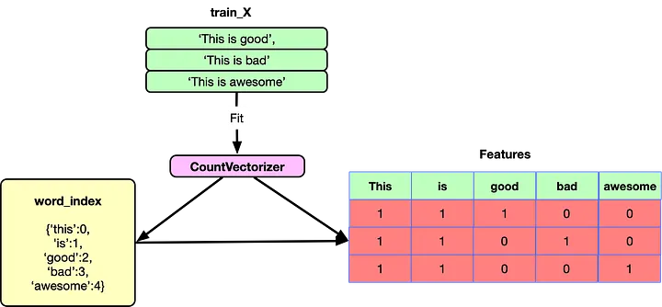
Methods
TF-IDF baseline recommender
SBERT embedding-based semantic model
Cosine similarity search
Notes:
Compare TF-IDF vs SBERT — keyword vs semantic.

Slide 7
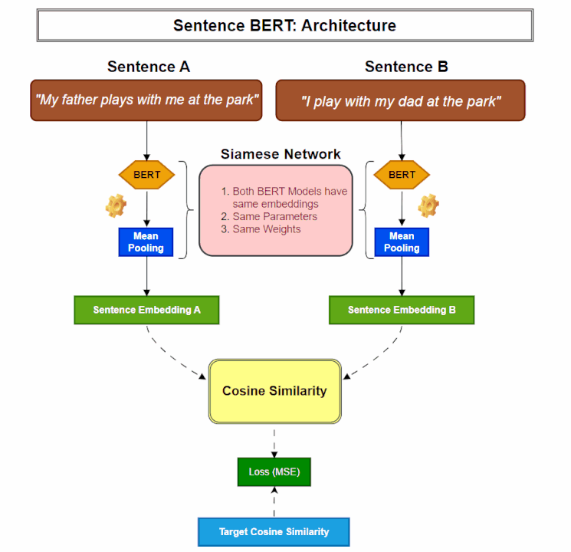
What is SBERT?
Neural model converting sentences into embeddings
Captures semantic and emotional meaning
Enabled +71% recommendation improvement
Notes:
Define SBERT: semantic embeddings — don't go too technical.

Slide 8
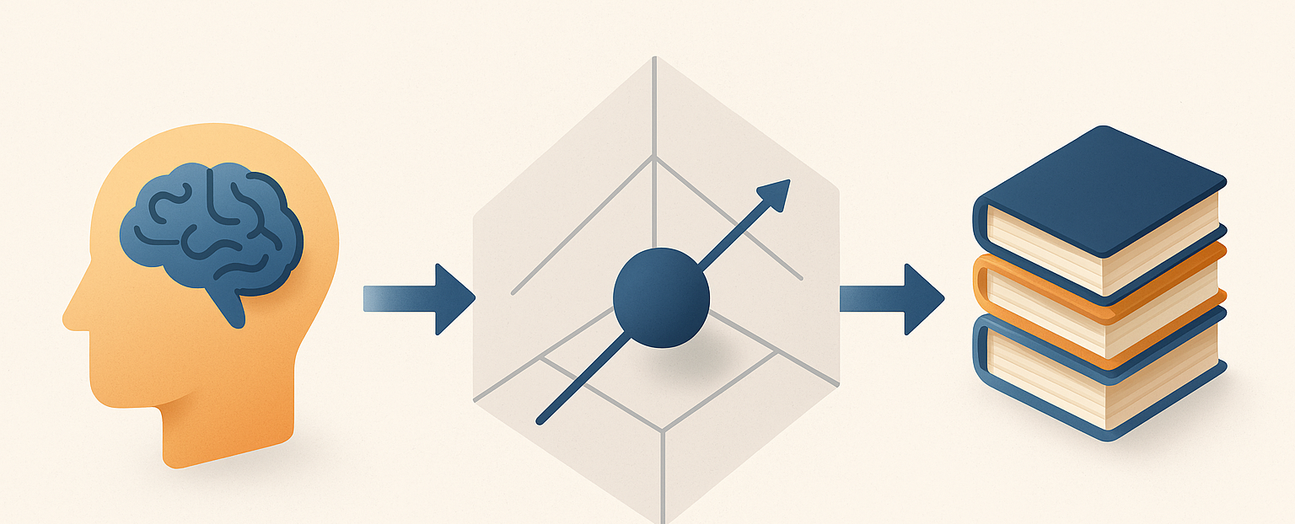
Architecture Overview
User emotion → embedding → similarity → ranked books
SBERT MiniLM-L6-v2 (384-dim embeddings)
Streamlit app deployment
Notes:
Walk audience through pipeline — show flow.

Slide 9


Evaluation Results
Precision@10 ↑ +71%
NDCG ↑ +113%
Avg rating ↑ +0.18★
Diversity ↑ +15%
Notes:
Draw attention to improvements — data speaks.

Slide 10
Examples
Anxious → The Miracle of Mindfulness
Similar to Harry Potter → James Potter series
Happy → The Happiness Project
PLACEHOLDER: Insert screenshot of Streamlit output
Notes:
Show examples — make emotional impact.

Slide 11

Live Demo https://schhetribooksrecommend.streamlit.app/
Switch between TF-IDF & SBERT
<1 second response
Emotional input field + ranking output
Notes:
Transition to demo — keep it short.

Slide 12
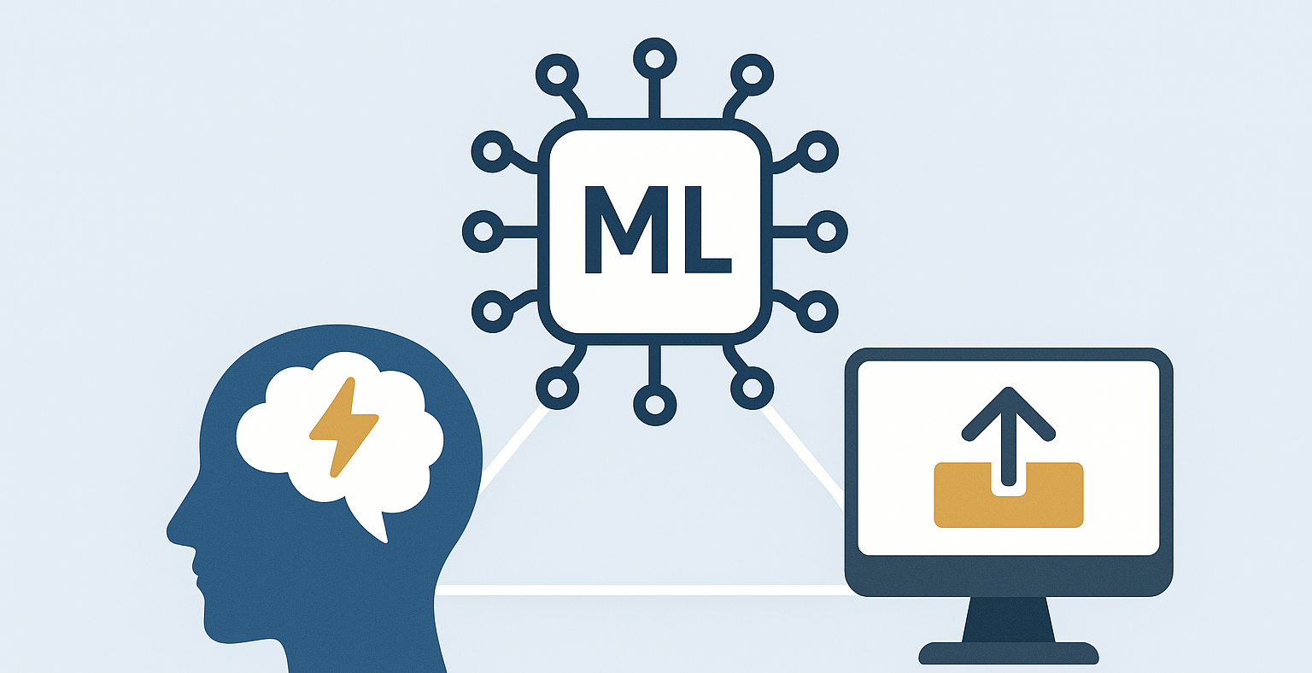
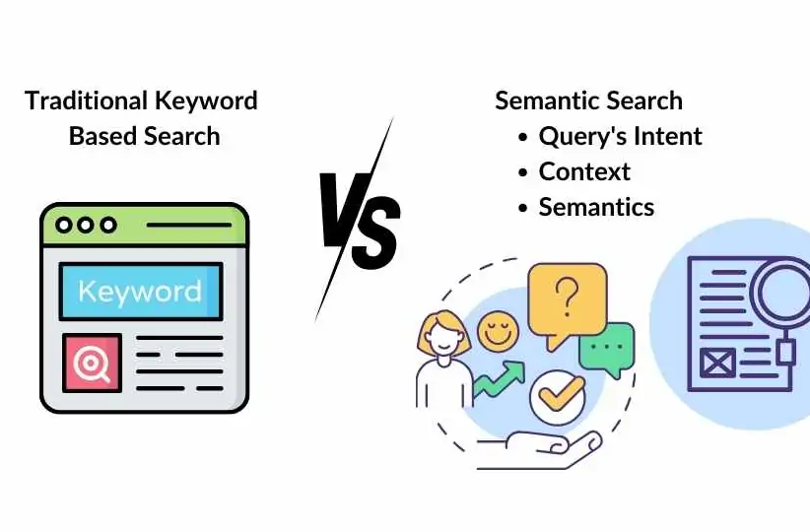
Learnings
Full ML lifecycle
Difference between keyword vs semantic NLP
Deploying ML for emotional well-being
Notes:
Share what YOU learned — this is the differentiator.

Slide 13

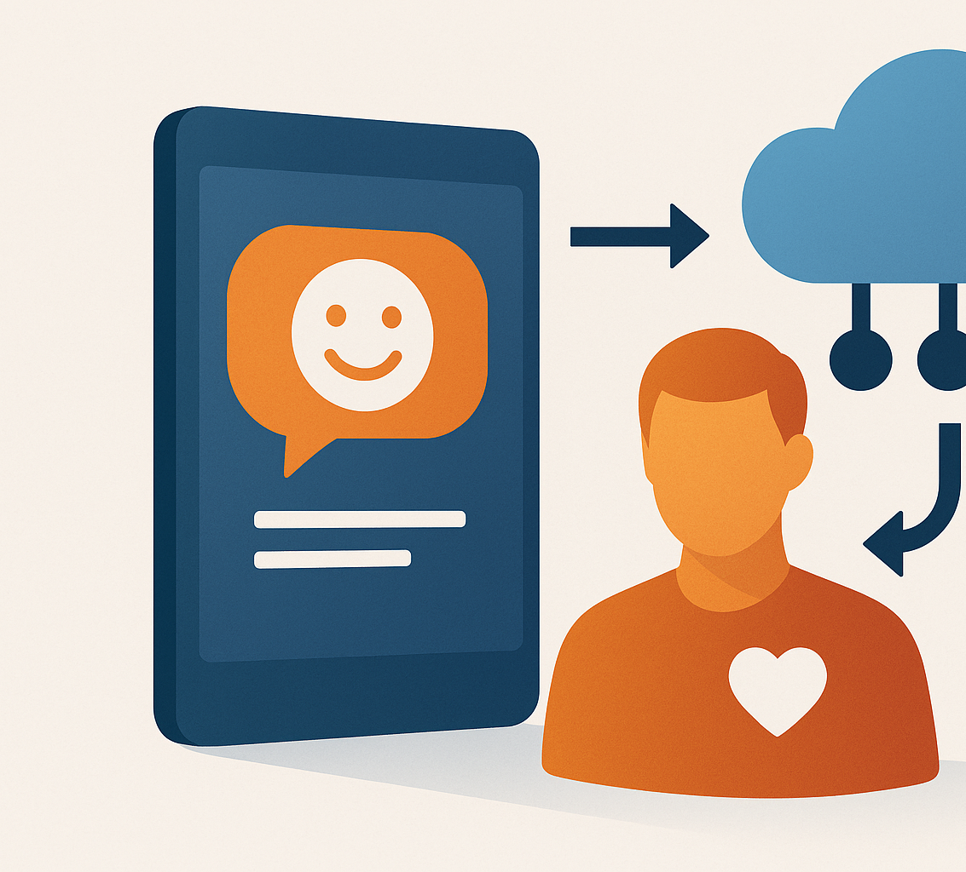
Future Enhancements
Add sentiment filtering
User personalization
Deploy public app on HuggingFace / AWS
Notes:
Future scope — shows vision & maturity.

Slide 14
2-Minute Interview Pitch
Quick Script:
1️⃣ Problem: Teens struggle emotionally. Reading can help — but only if matched.
2️⃣ Solution: Built an ML engine using SBERT embeddings to match mood → books.
3️⃣ Results: +71% Precision, +113% NDCG — significantly more relevant recommendations.
4️⃣ Deployment: Fully working Streamlit app — real-time recommendations.
5️⃣ Ask: Interested in DS/ML roles — especially NLP, edtech, or recommendation systems.

